Slide 1

Enhancing Search Engine Relevance for Video Subtitles

Slide 2
About me
Myself Bunty, and I have completed my graduation in BCA.
I want to learn data science because I'm fascinated by the insights it can uncover from vast amounts of data, helping solve complex problems and make better decisions.
The advancement in the field Machine Learning like GPT’s and LLM’s caught my interest.
I want to build my career in this field and contribute to the fullest with a growing mindset
Contact links :-
Linkedin
Github

Slide 3
Agenda
Objective
Read the database, decode its contents, and store them in the dataframe.
Data Pre-processing.
Create Document Chunker.
Store the vectors in ChromaDB database.
Create a Flask App for similarity Search of user queries.
Conclusion

Slide 4
1. Objective
In the fast-evolving landscape of digital content, effective search engines play a pivotal role in connecting users with relevant information. For Google, providing a seamless and accurate search experience is paramount. This project focuses on improving the search relevance for video subtitles, enhancing the accessibility of video content.
Develop an advanced search engine algorithm that efficiently retrieves subtitles based on user queries, with a specific emphasis on subtitle content. The primary goal is to leverage natural language processing and machine learning techniques to enhance the relevance and accuracy of search results.
2. Summary of Data
We have a dataset consisting of movie subtitles and web-series data from 1990 to 2024. The dataset is stored in a database with a table containing three columns: num (unique_id), movie_name, and movie_subtitle. The database is encoded in Latin-1 and it contains 82498 records.

Slide 5
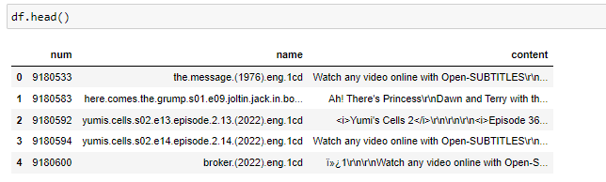
3. Read the database, decode its contents, and store them in the dataframe
Connect to the SQLite database
Execute SQL query to retrieve table names
Iterate through tables and read data
Check if content is in .ass format (contains "[Script Info]" header)
Extract dialogue lines using a regex that captures text after the last comma
Remove numeric identifiers and timestamps
Define function to decode compressed binary data and extract the subtitles
Apply our decoding and extraction function to the 'content' column
Append all the subtitles in dataframe.

Slide 6
4. Data Pre-processing
Handling Contractions( for example: "won't" (from "will not"))
Remove URLs
Remove timestamps
Remove HTML tags
Remove numbers
Remove blank new lines
Remove special characters except alphanumeric and spaces
Remove SDH (Subtitles for the Deaf and Hard of Hearing)
Remove speaker labels
Remove text between angle brackets <>
Remove text between curly brackets {}
Remove text between parentheses ()
Remove text between square brackets []
Remove text between asterisks *...*
Remove music note
Remove ellipses ...
Convert to lowercase

Slide 7
5. Create Documents Chunkers
Embedding an entire document as a single vector is impractical, especially for long documents, leading to information loss.
To address this issue, large documents are divided into smaller, manageable chunks for embedding.
This division involves setting overlapping windows with a specified token overlap to ensure shared tokens between chunks.
By dividing documents in this manner, we can effectively preserve more information during the embedding process.
This approach enhances the efficiency and accuracy of document embedding techniques.

Slide 8
6. Store Embedding in ChromaDB
We utilize BERT-based SentenceTransformers for generating embeddings, encoding semantic information.
Specify the storage location for embeddings in CHROMA_DATA_PATH, the embedding model in EMBED_MODEL, and the collection name in COLLECTION_NAME.
Instantiate a PersistentClient object to write embedding data to CHROMA_DB_PATH, ensuring data storage and persistence across new clients.
Alternatively, use chromadb.Client() to instantiate a ChromaDB instance that writes to memory, without persisting on disk.
Iterate over each row of the DataFrame and add chunks individually.
Create unique IDs for each chunk
Then, instantiate your embedding function and the ChromaDB collection for storing documents.
With documents embedded and stored in a collection, we’re ready to run some semantic queries.

Slide 9
7.1 Create Flask APP
Set Up ChromaDB:
Define constants like the path to ChromaDB data, embedding model to use, and collection name.
Initialize a PersistentClient from ChromaDB and load the collection.
Define Route for Search:
Create a route '/' that handles both GET and POST requests.
If the request method is POST, extract the user query from the form data.
Apply pre-processing steps to user_query.
Generate embeddings for the user query using the Sentence Transformer model.
Perform a search using ChromaDB based on the generated embeddings.
Render the search results page with the query and results.
If the request method is GET, simply render the search form.

Slide 10
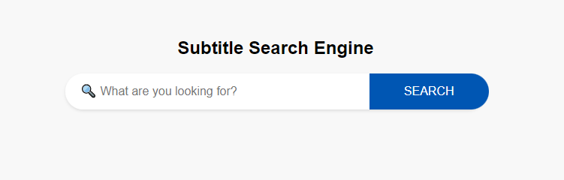
7.2. Create Flask APP
Perform Search Function:
Define a function perform_search that takes a query embedding as input.
Use ChromaDB to query for similar embeddings and retrieve the top 10 results.
Extract relevant information like IDs, distances, metadatas, and documents from the query results.
Combine the extracted information into a list of dictionaries representing each search result.

Slide 11
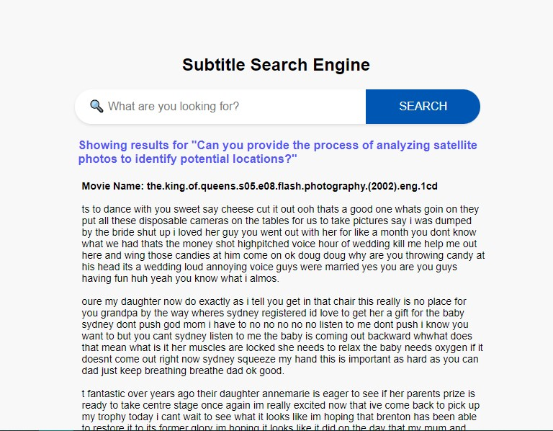
8. Output of Flask APP

Slide 12
9. Conclusions
Developed an advanced search engine algorithm leveraging natural language processing and machine learning techniques to enhance video subtitle search relevance and accuracy.
Implemented robust preprocessing steps including handling contractions, removing URLs, timestamps, HTML tags, numbers, and special characters, among others, to clean and standardize subtitle data.
Utilized BERT-based SentenceTransformers for generating embeddings and ChromaDB for efficient storage and retrieval of document embeddings, resulting in an effective semantic search capability for video subtitles.
Create a Flask web app in which users can enter a query and view the results..

Slide 13

THANK YOU

